Slide 1
Cover Page

Slide 2
1. Project Overview
Project Title: Online Student Course Registration Website
Problem Statement: Currently, students register for courses using paper forms or manual Google Forms. This process is slow, error-prone, and difficult for administrators to manage and track student enrollment.
Objectives:
Develop a responsive and user-friendly course registration website
Allow students to register and log in securely
Enable students to select and register for courses online
Provide an admin panel to manage courses and students

Slide 3
2. Project Charter
Section | Details
Purpose | To build a web-based system that allows students to register for courses online efficiently
Scope (requirement) | User authentication, course listing, student registration, admin dashboard, database storage
Milestones | Requirement Analysis (W2), UI Design (W4), Development (W8), Testing (W11), Final Presentation (W14)
Budget | 700$

Slide 4
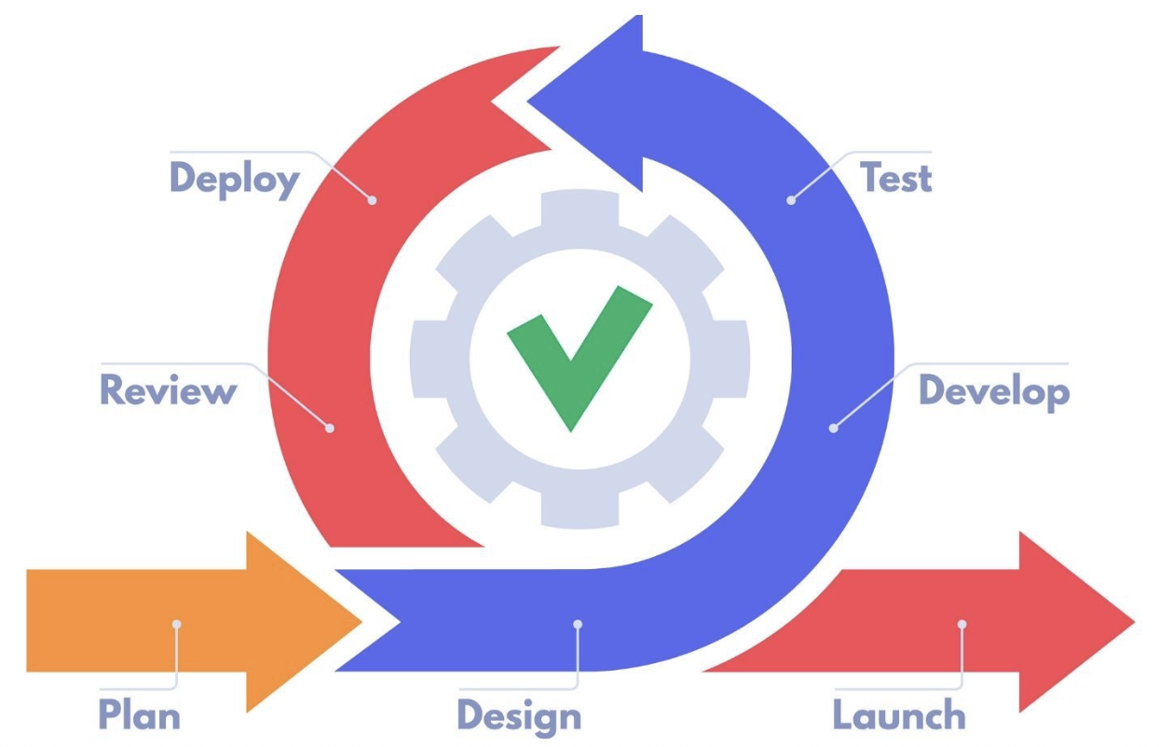
3. Project Method
Agile Methodology

Slide 5
3. Project Method
Why we choose agile
Allows flexible changes during development
Supports continuous feedback from instructor and team members
Tasks can be divided into small sprints for better progress
Suitable for student projects with limited time
Agile Practices Applied
Weekly team meetings
Sprint planning and task assignment
Continuous testing and improvement

Slide 6
4. Project Management Tool (Example 1)
Tool: Excel
Why Excel Is Chosen
Easy to understand for students
Suitable for planning, tracking, and reporting
No cost and widely available

Slide 7
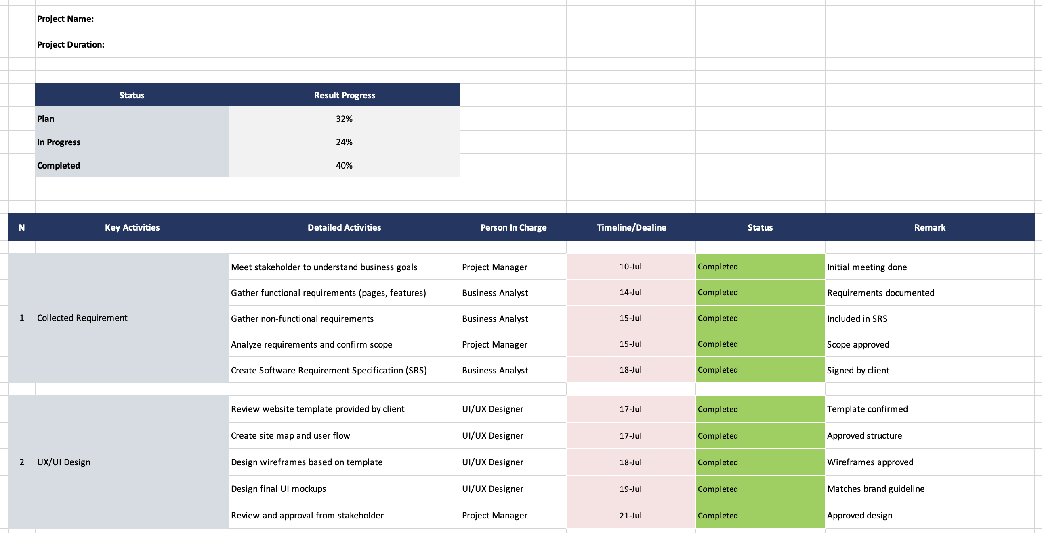
4. Project Management Tool (Example 1)
Demo and explain using project management tool to assign task, tracking and monitoring task to manage task in your project

Slide 8
4. Project Management Tool (Example 2)
Tool: Asana Tool
Why Asana Is Chosen
Easy Task Assignment and Responsibility Control
Clear Task Tracking (Planned → In Progress → Completed)
Effective Monitoring of Project Progress
Supports Agile Project Management Method
Easy for Team Communication and Collaboration

Slide 9
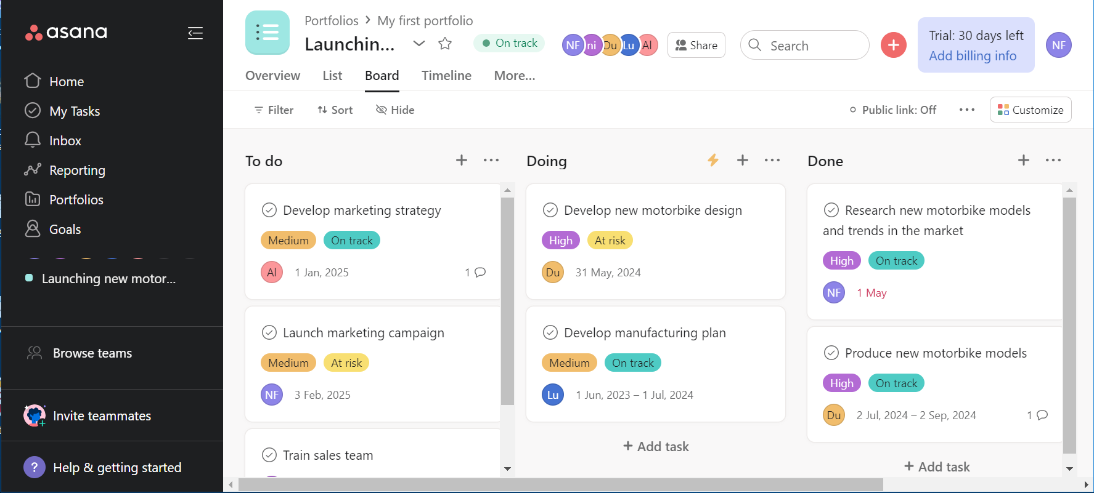
4. Project Management Tool (Example 2)
Demo and explain using project management tool to assign task, tracking and monitoring task to manage task in your project

